Slide 1


Using Latex and Overleaf
cdcs@ed.ac.uk

Slide 2

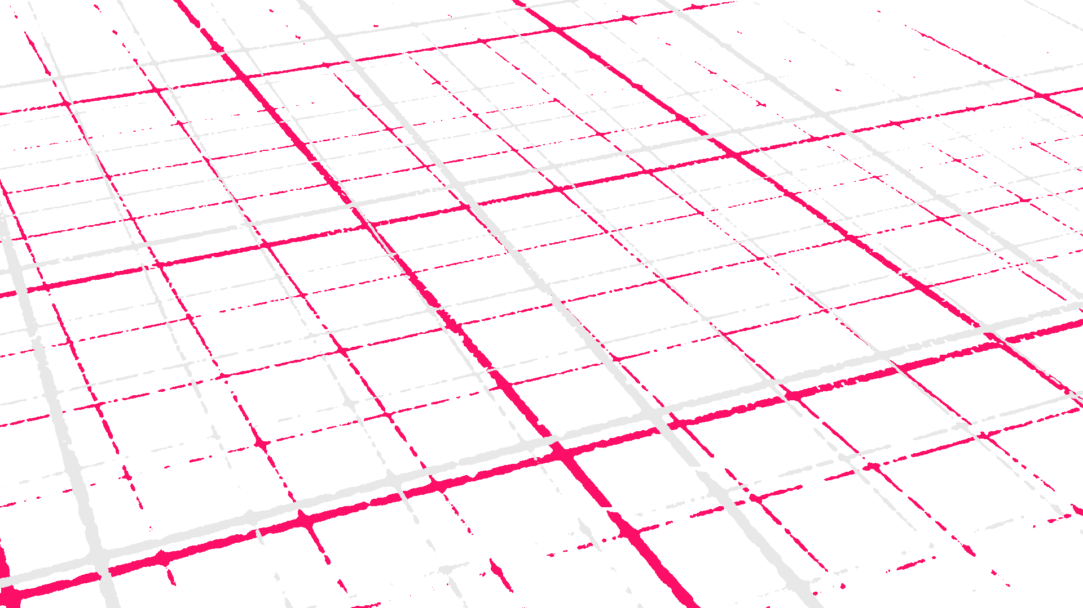

@EdCDCS
For all events, news, and support: cdcs.ed.ac.uk

Slide 3
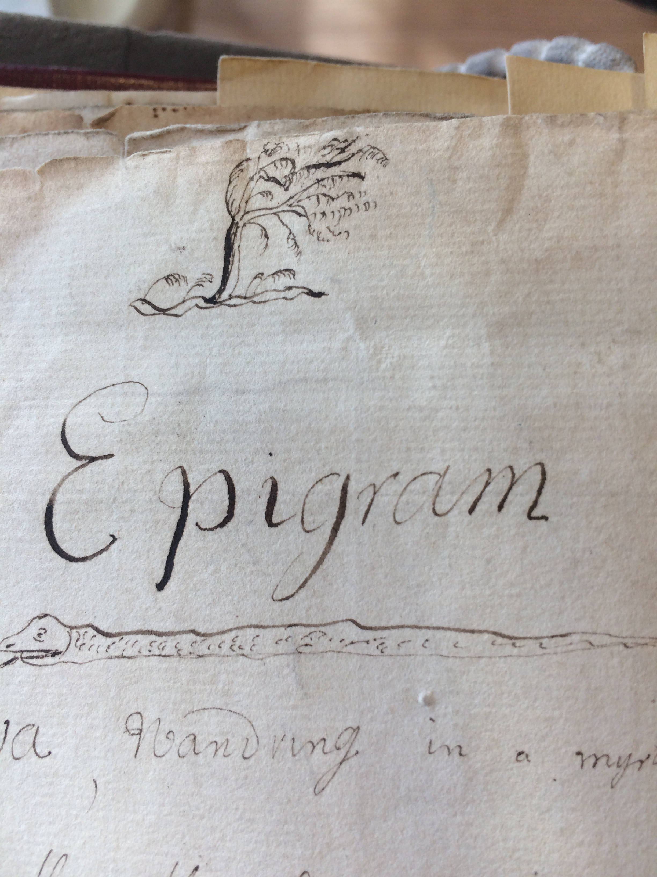
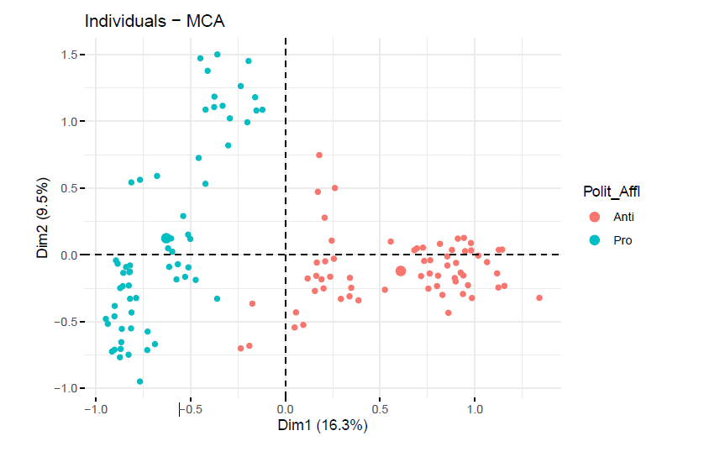
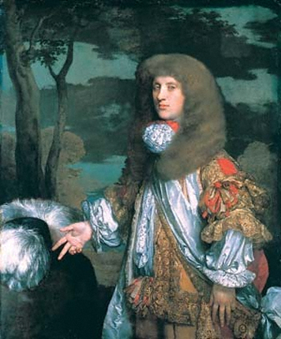
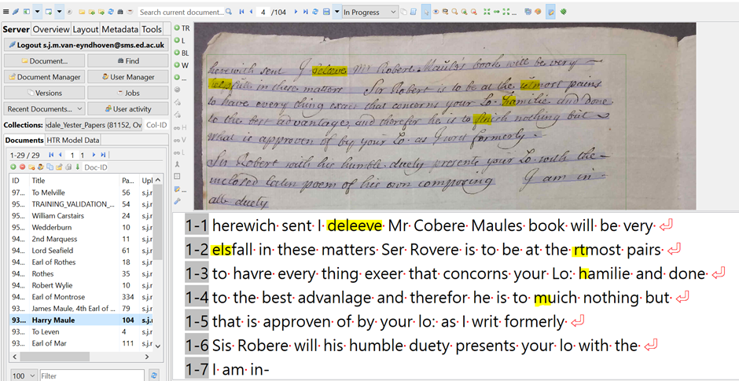

Before starting …
Who are we?
Sarah Schöttler
Sarah van Eyndhoven
PhD in Linguistics from UEd
Digitising 18th c. letters
Training fellow with DCS

Slide 4

Today's program
What is LaTeX? And what is Overleaf? Why use them?
Different types of documents
Writing your first piece of LaTeX
The preamble of a document
Adding a title, author and date
Bold, Italics and Underlining
Formatting, Text Alignment
Using Colours
www.cdcs.ed.ac.uk

Slide 5
Today's program
Working with images
Tables
Lists
Formulas and equations
www.cdcs.ed.ac.uk

Slide 6

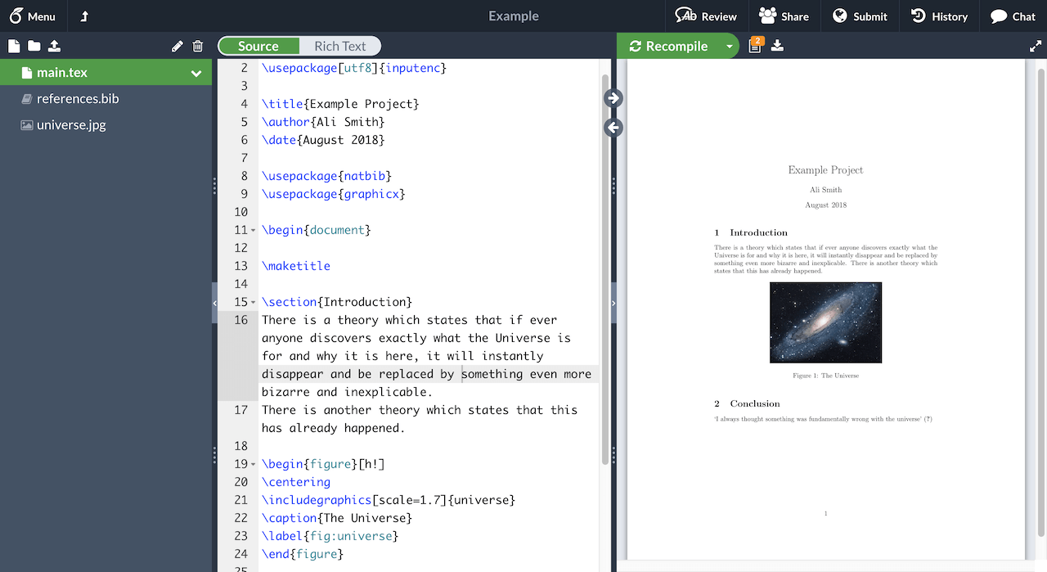

What is Latex?
LATEX (pronounced LAY-tek or LAH-tek) is a tool used to create professional-looking documents. It is based on the WYSIWYM (what you see is what you mean) idea, meaning you only have focus on the contents of your document and the computer will take care of the formatting. Instead of spacing out text on a page to control formatting, as with Microsoft Word or LibreOffice Writer, users can enter plain text and let LATEX take care of the rest.
www.cdcs.ed.ac.uk

Slide 7

Why learn Latex?
LATEX is used for scientific documents, books, as well as many other forms of publishing.
It allows users to very quickly tackle the more complicated parts of typesetting automatically (e.g. Table of Contents)
Packages allow users to add footnotes, draw schematics, create tables etc.
It separates the content of the document from the style. This means that once you have written the content of your document, we can change its appearance with ease.
You can create one style of document which can be used for many different documents.
Many scientific journals create templates for submissions. These templates have a pre-made layout meaning that only the content needs to be added.
There are hundreds of templates available for everything from CVs to slideshows.
www.cdcs.ed.ac.uk

Slide 8
Why might you not have learnt Latex before?
Takes time to learn it
Some journals want the .docx file
You do not need much formatting
You do not want to imagine googling the results of Latex
www.cdcs.ed.ac.uk

Slide 9

What is Overleaf?
Overleaf is a startup and social enterprise that builds modern collaborative authoring tools to help make science and research faster, more open and more transparent
Overleaf’s market-leading collaboration technology is now in use by over four million researchers, students, and teachers in institutions, labs, and industry worldwide
Basically, it is a web-based tool using Latex to create and share documents
It allows you to create and modify texts in Latex and work collaboratively
Not open but you have access to the pro version with your university e-mail
Lots of models available (not many from the Edinburgh University).
www.cdcs.ed.ac.uk

Slide 10
Why use Overleaf?
Fewer bugs to deal with regarding document compilation
Saves space on your computer
Works everywhere
No worries about updates
Direct submission to some journals
Interconnection with Git and Github to work in version control
Easy collaboration
Let’s Create an account
https://www.overleaf.com/edu/edinburgh
www.cdcs.ed.ac.uk

Slide 11
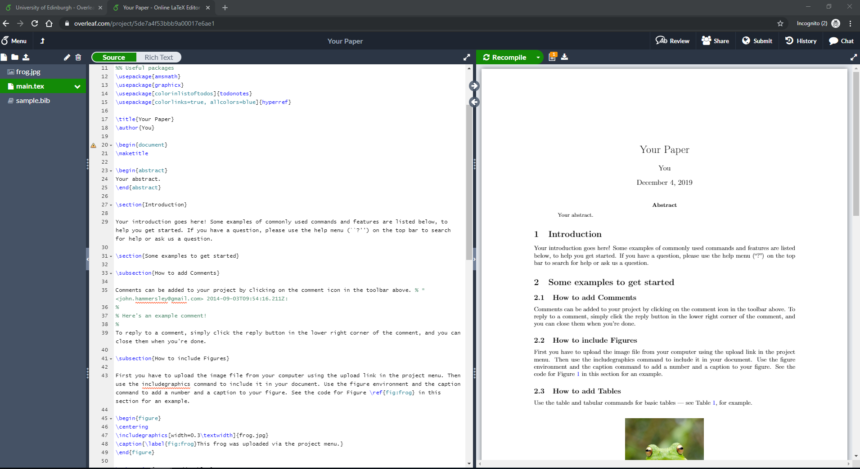
The Overleaf interface
www.cdcs.ed.ac.uk

Slide 12

Anatomy of Overleaf files
A .Tex file that contains text and commands
A .bib file that contains the bibliography
Any additional files: pictures, graphs etc…
Additional .cls or .sty files that contains specific documents classes or styles
Many different types of docs
https://www.overleaf.com/read/jzxjhxggtsnh
www.cdcs.ed.ac.uk

Slide 13
The preamble of a document
\documentclass{book}
\usepackage[utf8]{inputenc}
\title{example}
\author{Lucia Michielin}
\date{December 2019}
\begin{document}
\maketitle
\section{Introduction}
\end{document}
Type of document
Type of encoding
Title of your document
Author/s
Date
Start of the proper document
Write the title
Start of the first section
End of the document
www.cdcs.ed.ac.uk

Slide 14
Adding a title, author and date
\title{{Bla Bla Bla\\
Bla Bla subtitle}\\
[15 pt]{\large Institution}\\
[45 pt]{\includegraphics
[width=0.25\textwidth]{logo.png}}}%
\author{Your Name}
\date{November 2021}
Title
Subtitle on a new row
Institution on smaller font
Add image
Image
Author
Date
www.cdcs.ed.ac.uk

Slide 15
Bold, Italic, underlining
\textit{everything in here is italic}
\textbf{everything in here is bold}
\underline{everything in here is underlined}
www.cdcs.ed.ac.uk

Slide 16
Text Alignment
\begin{flushright}
All of what I write here will be right aligned
\end{flushright}
\begin{center}
All of what I write here will be centered
\end{center}
More on text alignment
https://www.overleaf.com/learn/latex/Text_alignment
www.cdcs.ed.ac.uk

Slide 17
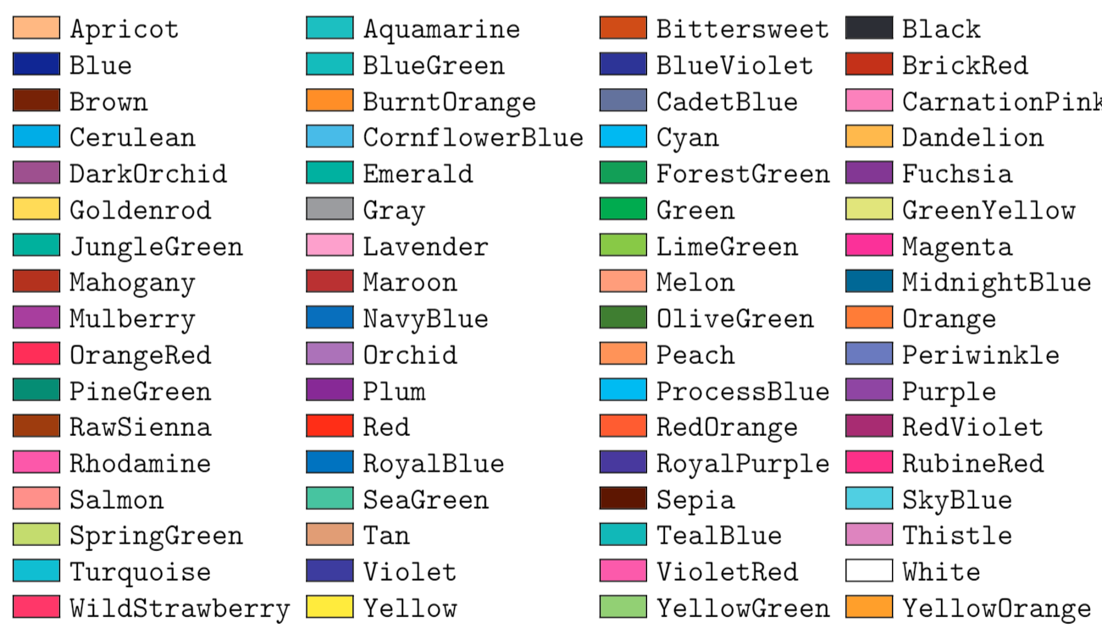
Using Colours
% Use colours
\usepackage[dvipsnames]{xcolor}
%in text
\textcolor{ForestGreen}{text to be coloured}
%Coloured line
{\color{RubineRed} \rule{\linewidth}{0.5mm}}
%Colour Box
\colorbox{BurntOrange}{orange background}
www.cdcs.ed.ac.uk

Slide 18
Adding images
%import and use packages for graphics and images
\usepackage{graphicx}
\usepackage{wrapfig}
\graphicspath{ {images/} }
\usepackage{caption}
\captionsetup[figure]{font=small}
www.cdcs.ed.ac.uk

Slide 19
Adding images
Specifier | Permission
h | Place the float here, i.e., approximately at the same point it occurs in the source text (however, not exactly at the spot)
t | Position at the top of the page.
b | Position at the bottom of the page.
p | Put on a special page for floats only.
! | Override internal parameters LaTeX uses for determining "good" float positions.
H | Places the float at precisely the location in the LaTeX code. Requires the float package (\usepackage{float}). This is somewhat equivalent to h!.
www.cdcs.ed.ac.uk

Slide 20
Adding images
%Image in text
\noindent %do not indent pic
\begin{wrapfigure} %Start the package wrapped figure
{l} %aligned at left
{0.50\textwidth} %make it 50% of the width of the text
\includegraphics[width=0.50\textwidth] %add image and scale to the 50% of text
{images/Fig1.jpg} % locate image
\caption{Example of Intext image} % Caption
\label{fig:2_1} %Label of the image(image ID)
\end{wrapfigure} %End of the command
%Image all space
\begin{figure} %start the image
[h] %put the image in this exact location
\includegraphics[width=\textwidth] %add image and scale to the 100% of text
{images/Fig2.jpeg} % locate image
\caption[margin=10pt] % Caption
{This is the caption of the full text images bla bla bla} % Caption
\label{fig:7_2} %Label of the image(image ID)
\end{figure} %End of the command
www.cdcs.ed.ac.uk

Slide 21
Tables
Standard centered table
\begin{table}[h!] %Start table
\centering % center table
\begin{tabular}{ |c|c|c| } %number of column or you can fix the size with { |m{5cm}|m{1cm}| m{1cm}|} need array package
\hline % horizontal line
Col1 & Col2 & Col3 \\
\hline % horizontal line
cell4 & cell5 & cell6 \\
cell7 & cell8 & cell9 \\
\hline % horizontal line
\end{tabular}
\caption{Table to test captions and labels} } %Caption table
\label{table:1} %Label table for cross ref
\end{table} %Start table
www.cdcs.ed.ac.uk

Slide 22
Lists
Bullet points
\begin{itemize} % start numbered lists
\item The labels consists of sequential numbers.
\item The numbers starts at 1 with every call to the enumerate environment.
\end{itemized} % stop numbered lists
Numbers
\begin{enumerate} % start numbered lists
\item The labels consists of sequential numbers.
\item The numbers starts at 1 with every call to the enumerate environment.
\end{enumerate} % stop numbered lists
Nested
\begin{enumerate} % start numbered lists
\item First level1.
\begin{enumerate} % start bullet lists
\item second level.
\end{enumerate} % stop numbered lists
\item First level2.
\end{enumerate} % stop numbered lists
www.cdcs.ed.ac.uk

Slide 23
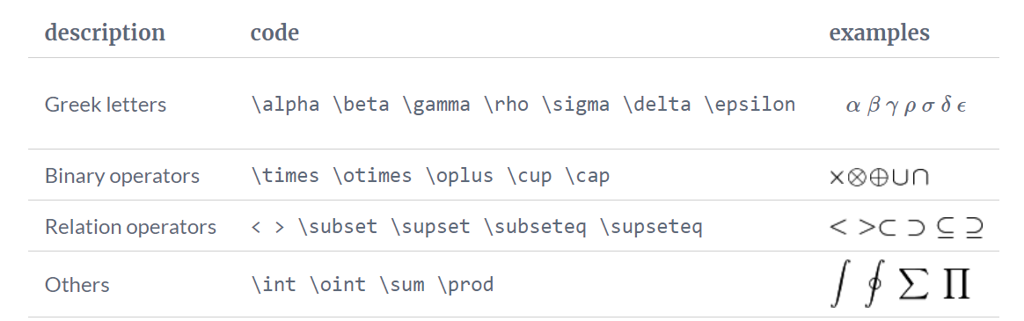
Formulas and Equations
www.cdcs.ed.ac.uk

Slide 24
Formulas and Equations
Simple unnumbered equation
\[E=mc^2\]or \(E=mc^2\)in text
Equation
\begin{equation} % start equation command
E=mc^2 % formula
\label{eq2} % Label for crossref
\end{equation} % end equation command
Multiple line solution
\begin{equation} \label{eq2} % start equation command +labelling
\begin {split} % start splitting
MyVariable & = P(s^2\cdot t)\\ % First row
& = 2.02(876.16 \cdot 0.4)\\ % Second row
& = 707.94(gr) etc.. % Third row
\end{split} % stop splitting
\end{equation} % end equation command
www.cdcs.ed.ac.uk

Slide 25
Cross referencing images and equations
Cross Ref Figure
\ref{Figure:id}
Cross Ref Equation
\ref{Equation:id}
Cross Ref Table
\ref{Table:id}
Cross referencing will make the reference update automatically if you add more images or equation before in the chapter!
www.cdcs.ed.ac.uk

Slide 26
Today's program
Chapters
Table of Contents
Citations
References and Bibliography
Play around with your template!
www.cdcs.ed.ac.uk

Slide 27
Chapters and Sections
-1 | \part{part}
0 | \chapter{chapter}
1 | \section{section}
2 | \subsection{subsection}
3 | \subsubsection{subsubsection}
4 | \paragraph{paragraph}
5 | \subparagraph{subparagraph}
\chapter{Introduction}
\input{actualchapters/introduction}
\chapter{Literature Review}
\input{actualchapters/Chapter 2}
www.cdcs.ed.ac.uk

Slide 28
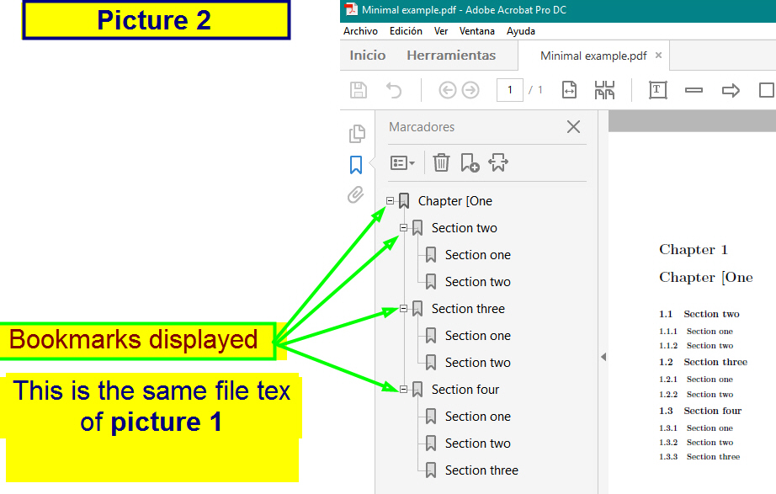
Table of Contexts
%Call the TOC
\tableofcontents
%set level of counting for table of contents
\setcounter{tocdepth}{3}%how deep to display in toc
\setcounter{secnumdepth}{3}% till what number
% to add for any chapter not numbered. This is to
have a stand-alone chapter not within in the toc
\addcontentsline{toc}{chapter}{Abstract}
%add bookmark
\usepackage{bookmark}
www.cdcs.ed.ac.uk

Slide 29
References
There are a number of different packages in LaTex that format citations and bibliographies, including Biblatex, Bibtex and Natbib
To cite references in Latex, you need a bibliography file. This is a .bib file we need to provide ourselves
Reference management software such as Zotero, Mendeley etc can create .bib files
.BIB example
@book{Croom2011,
address = {Cambridge},
author = {Croom, Alexandra},
publisher = {The History Press},
title = {{Running the Roman home}},
year = {2011}
}
BibTeX the file format vs BibTeX the software tool
“BibTeX” is both used to refer to a reference management package and to the file format used by this software (i.e. a .bib file)
Bibtex and Biber are external programs that process bibliography information and act (roughly) as the interface between your .bib file and your LaTeX document.
www.cdcs.ed.ac.uk

Slide 30
References
Natbib: For Traditional and Flexible Citation Styles
package designed for flexibility in citation style
supports both author-year and numerical citations
customization to match a variety of citation formats
simple to use and is compatible with most LaTeX documents
BUT: functionality is relatively basic - for more complex citation requirements, you might need to look elsewhere
Bibtex: For Ease and Compatibility
main strength = compatibility and ease of use
Many academic journals accept Bibtex
Extensive online documentation
BUT: doesn't handle Unicode well, so tricky for non-English languages
Biblatex: For Advanced and Multilingual Needs
modern package that provides more advanced features than Natbib or Bibtex
handles Unicode well
supports a wider range of citation styles
allows for more customization
BUT: requires the use of Biber as the backend for sorting and processing bibliographic data
www.cdcs.ed.ac.uk

Slide 31
References
Summary?
Natbib is great for simple documents requiring traditional citation styles
Bibtex is an excellent choice for compatibility and ease of use, especially when
writing for journals that support Bibtex format.
Biblatex is the best choice for complex or multilingual documents, or if you need
more customisation in your citations
www.cdcs.ed.ac.uk

Slide 32
Natbib
Today we will focus on using Natbib (most common in Humanities)
Commands:
\usepackage{natbib} % use Natbib citation package
\setcitestyle{aysep={,}} % Set cite style, and put comma between author and year (can also be space ; : etc)
\setcitestyle{notesep={: }} % Put colon between author/year and info in 'note' field (usually pg #)
\setcitestyle{yysep={,} % Separator between years with common author
\bibliography{References.bib} % Give the name of the bibliography file
\bibliographystyle{apalike} % Style of biblio and citation
\addcontentsline{toc}{chapter}{Bibliography} % Add biblio to table of contents
\chapter*{Bibliography} % Call it bibliography rather than references
\markboth{Bibliography}{Bibliography} % Add biblio in header
www.cdcs.ed.ac.uk

Slide 33
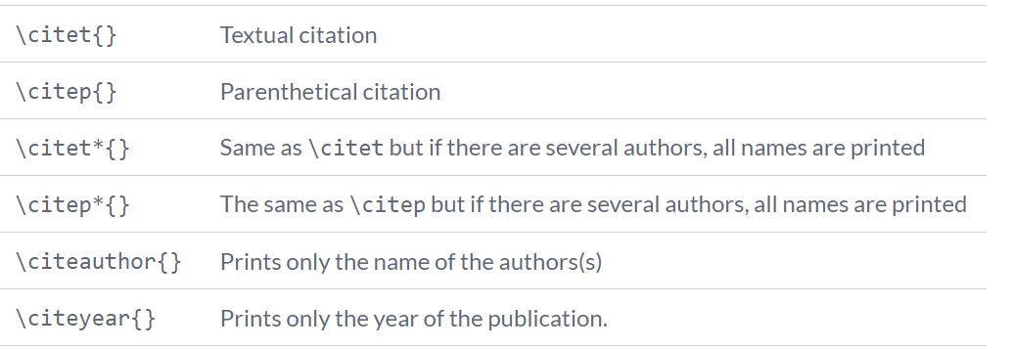
Citations
Natbib options
www.cdcs.ed.ac.uk

Slide 34
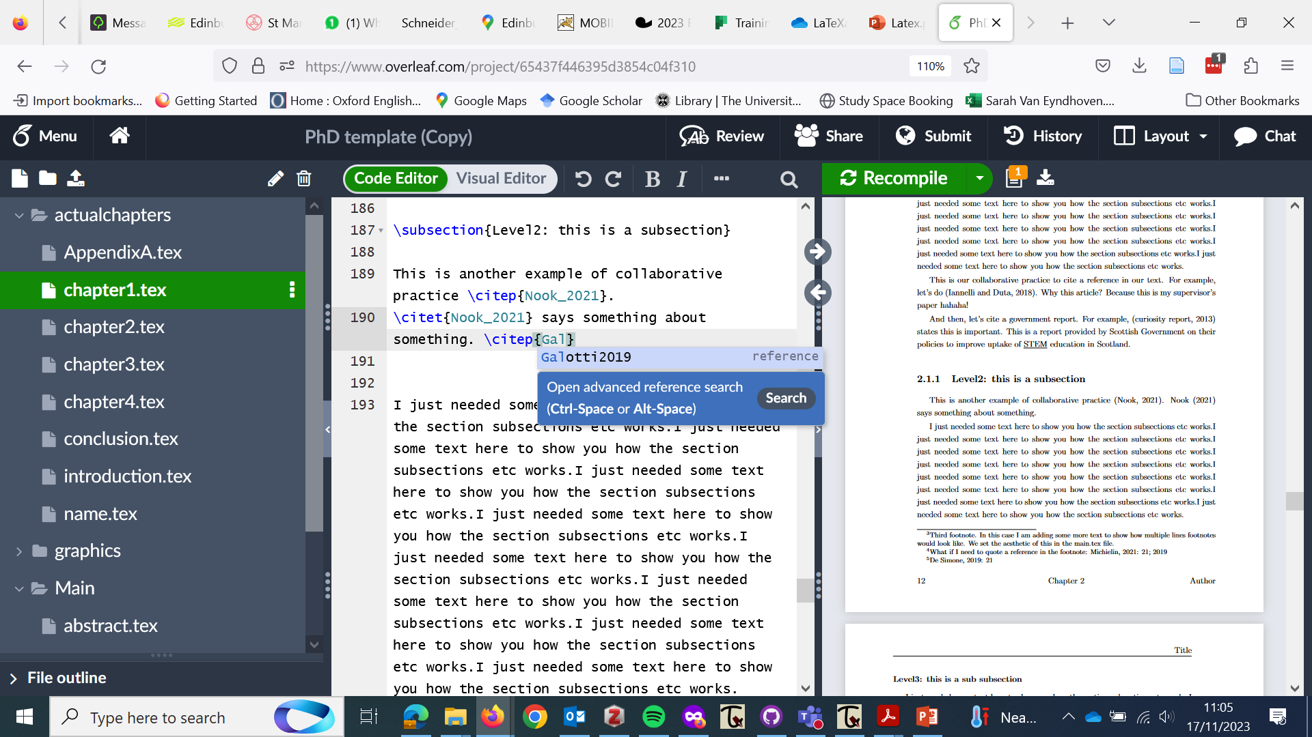
Citations
Your .bib file will assign a shorthand name to each reference, e.g. Galotti2019. This is usually based off the author of the text.
Normally, you can just start typing the name of the author, e.g. "Galo-" and Latex will provide a dropdown box with possible options to choose from, e.g. Galotti2019
www.cdcs.ed.ac.uk

Slide 35
Citations
Citing in-text
\citet{} - see for example Brown et al., 1987
\citet*{} - see for example Brown, Levinson and Gunther, 1987
\citep{} - (Macinnes, 2007) OR with \setcitestyle{authoryear, open={(},close={)} and \cite{}
\citep*{} - (Johnson, Smith & Colley, 2007)
\citep[272]{} - (Macinnes, 2007: 272)
\citep[see][272]{} - (see Macinnes, 2007: 272)
(\citealp[]{}; \citealp[]{}) - (McMillan, 2005: 34; Macinnes 2007: 294)
\citeyear or \citeyearpar{} - as Cruickshank (2012) argues...
\citeauthor{} - indeed, Cruickshank suggested that..
More on Citation styles
https://www.overleaf.com/learn/latex/Biblatex_citation_styles
www.cdcs.ed.ac.uk

Slide 36
Citations: Footnotes
The footnote command is very easy
\footnote{Here goes the text I want in my footnote}
Using footnotes for citations
I'm going to cite someone now\footnote{\citet[21]{Michielin2019}; \citeyear{Binford2021} }
Output: I'm going to cite someone now⁴
⁴Michielin 2019: 21; 2021
www.cdcs.ed.ac.uk

Slide 37
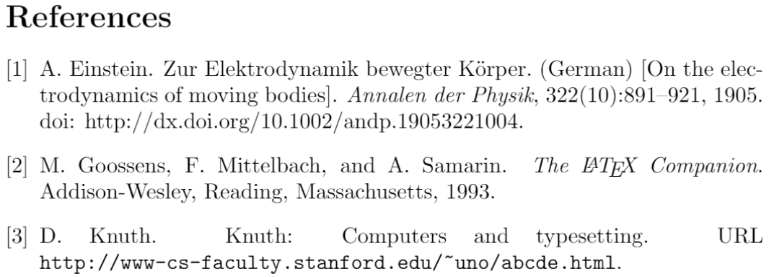
Numerical Citations
\usepackage[square,numbers]{natbib} \bibliographystyle{abbrvnat}
Latex Text:
The Einstein journal paper\citet{einstein}, and the Donald Knuth's website \cite{knuthwebsite}. The \LaTeX\ related items are \cite{latexcompanion,knuthwebsite}.
Output:
The Einstein journal paper [1], and Donald Knuth's website [3]. The Latex related items are [2, 3].
www.cdcs.ed.ac.uk

Slide 38
Your turn!
Either open up the PhD template included in the Github depository, or open a template of your own (from a journal, publication, shared document etc.)
Have a play with some of the commands, and wave one of us over if you get stuck
Please ask questions! We are here to help :)
www.cdcs.ed.ac.uk

Slide 39
Extra material: Import Tables from R
library (tidyverse)
#Create breakout table of something
FlowersBreakout<- iris %>%
group_by(Species) %>%
summarize(meanSepal = mean(Sepal.Length), meanPetal= mean(Petal.Length), number=n())
#Install and mount required packages
install.packages("xtable")
library(xtable)
print(xtable(FlowersBreakout, type = "latex", row.names = FALSE), file = "flowers.tex")
Then import the .text file in your project and use \input{images/flowers}
www.cdcs.ed.ac.uk

Slide 40
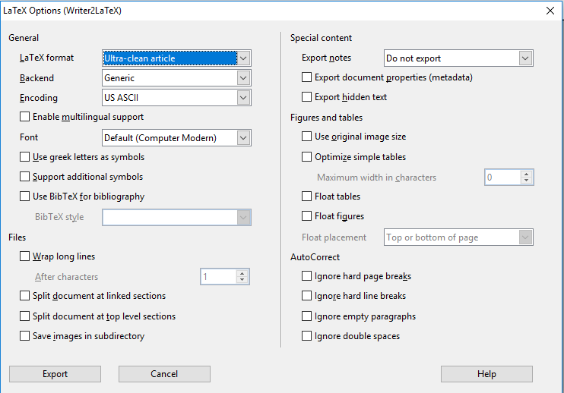
Import from Openoffice
Download the extension
https://extensions.libreoffice.org/extensions/writer2latex-1/1-6.1
You need either Open office or Libre office no free plugin for word
Go to tools > Extension manager and add the new extension
Go to Export > Select LaTeX 2e etc in file extension
Save
In overleaf navigate to the folder you want it in and upload it
www.cdcs.ed.ac.uk

Slide 41
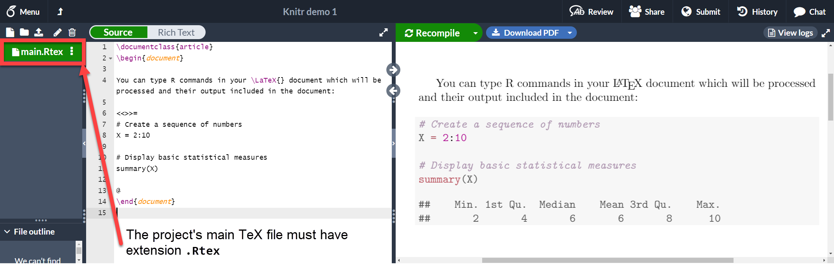
Snippets of code
\usepackage{listings}
https://www.overleaf.com/learn/latex/Knitr
www.cdcs.ed.ac.uk

